Slide 1


BACK TO BASS'ICS
Miguel Morell
Cristian Lagranda
Ariele Amorim

Slide 2
Miguel
Morell
OUR TEAM
Cristian
Lagranda
Ariele
Amorim

Slide 3
CHALLENGE
Drummers and Bass player must be in union…
What happens if one of them is not there?

Slide 4

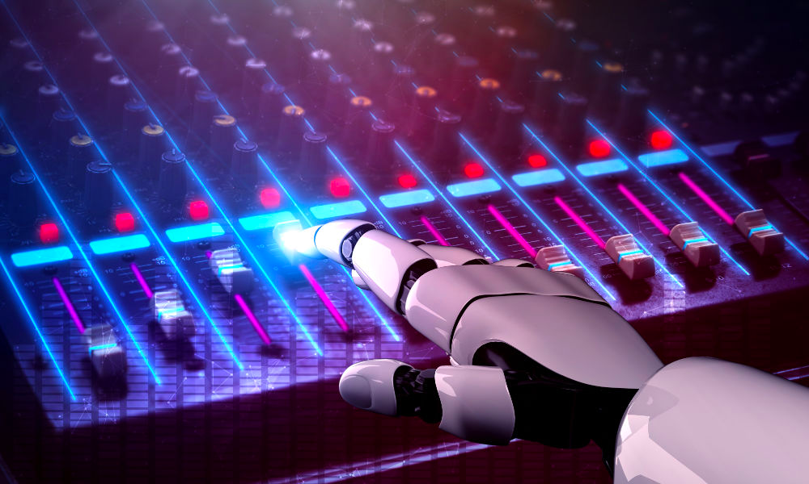
SOLUTION
Back to BASS'ics

Slide 5

HOW IT WORKS?
User's Input
(Drums)
Output
(Bass & Drums)
LSTM-MODEL

Slide 6

Thank You!

